Slide 1
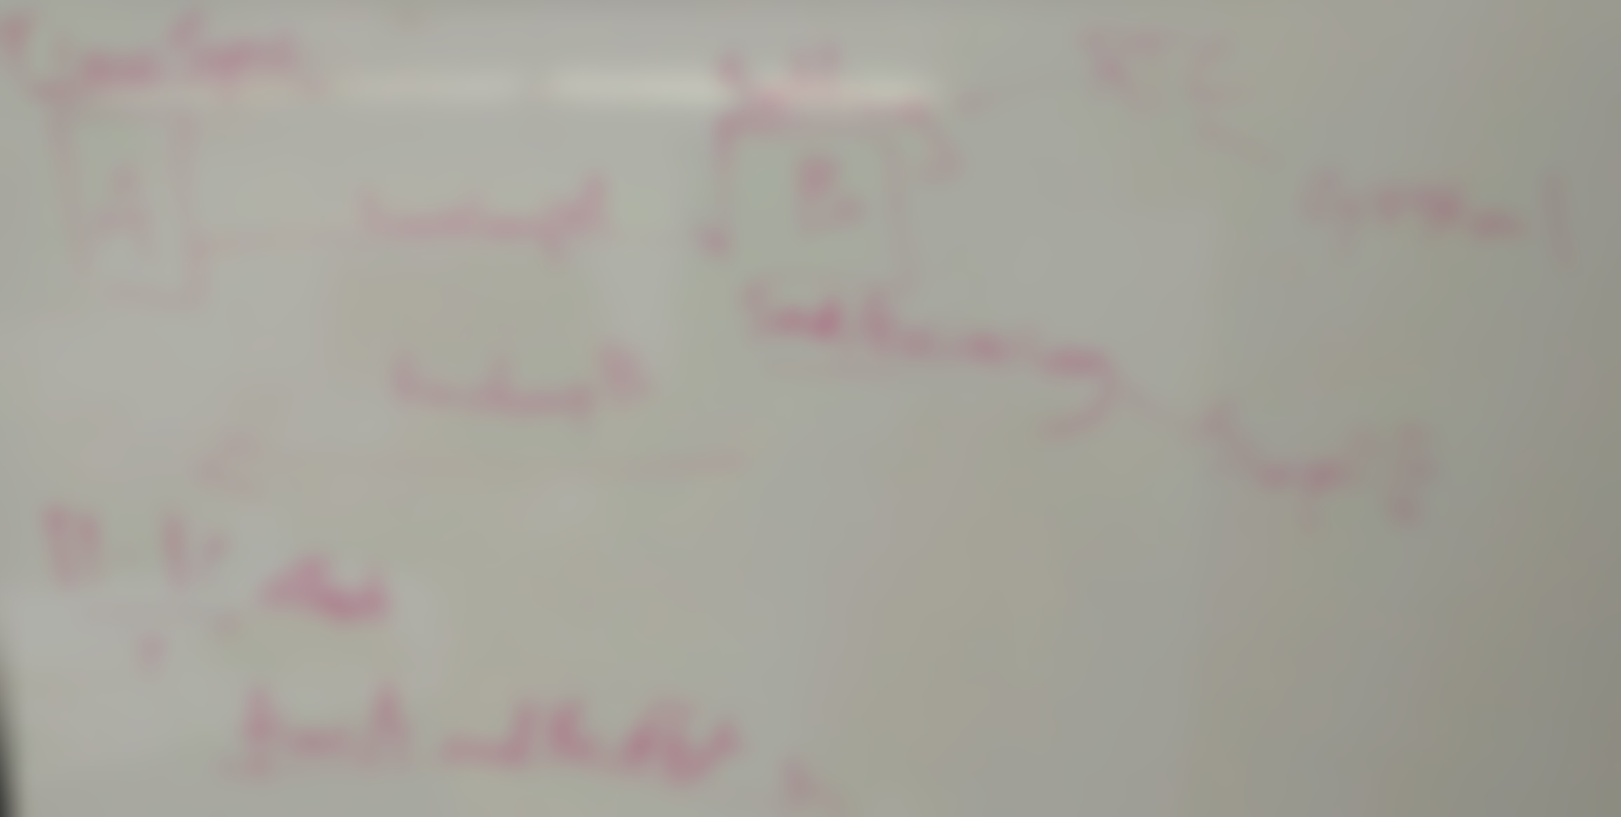
KineTrax
KineJax

Slide 2
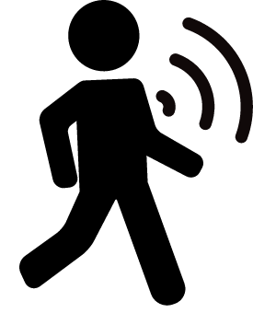
Capstone Team
KineJax Team:
Chris Whitney - Team Lead
Anthony Black - Security Assurance
Cherie Parsons - Recorder
Jack Jenkins - Release Manager
Grant Swenson - Editor

Slide 3
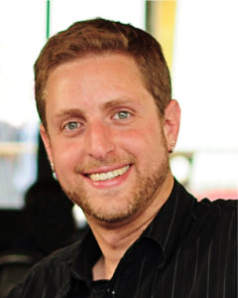
Mentor/ Client
Faculty Mentor/ Client
Kyle Winfree
  BS Physics
  MES Robotics
  PhD Biomechanics and Movement Science
Part of SICCS department here at NAU
Interest in:
  Using wearable technologies to measure and improve healthcare.
Notes:
Moar degrees

Slide 4
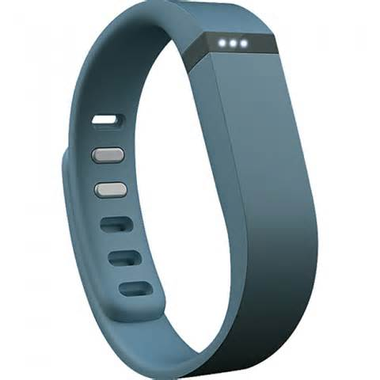
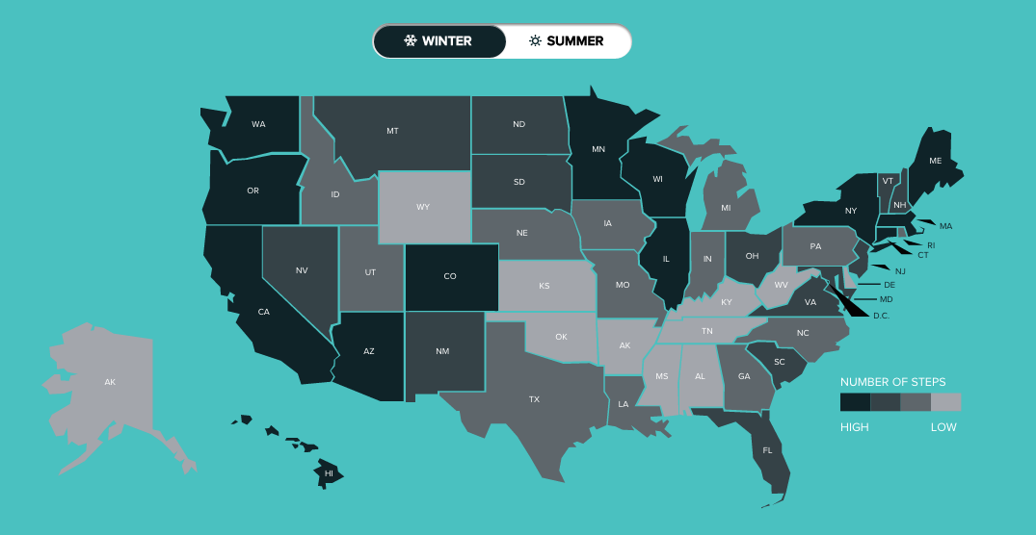
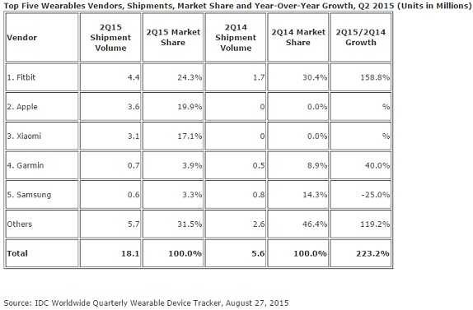
Background - Wearables
Average Daily Steps per State
Notes:
Fitbit talk: Since 2010, Fitbit has sold 38 million devices worldwide. Fitbit has controlled the majority of the market
Fitbit publishes number of units sold, they control the majority of the market, add this kind of information
Seeding the market
Real time feedback
Provides more personal data:
Real time feedback:
Comparison of friends and global data:
Analysis of trends: Steps based on region, heart rate, calorie consumption, and many other trends.

Slide 5
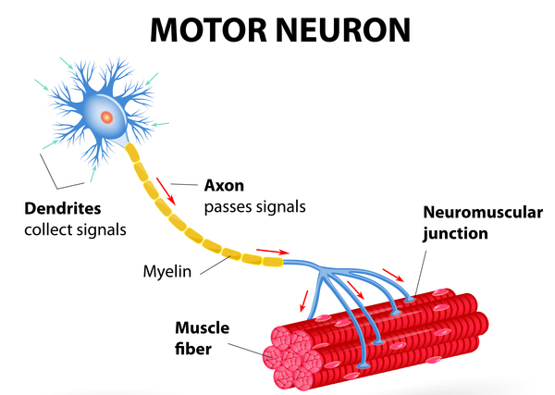
Background - Neurodegenerative Disorders
Notes:
Neurological Impairments affect a lot of people
Parkinson’s (500,000+)
Multiple Sclerosis (400,000+)
Amyotrophic Lateral Sclerosis (20,000+)
Impairments impact gait/ movement
Can be seen in stride
Changes may or may not be noticeable

Slide 6
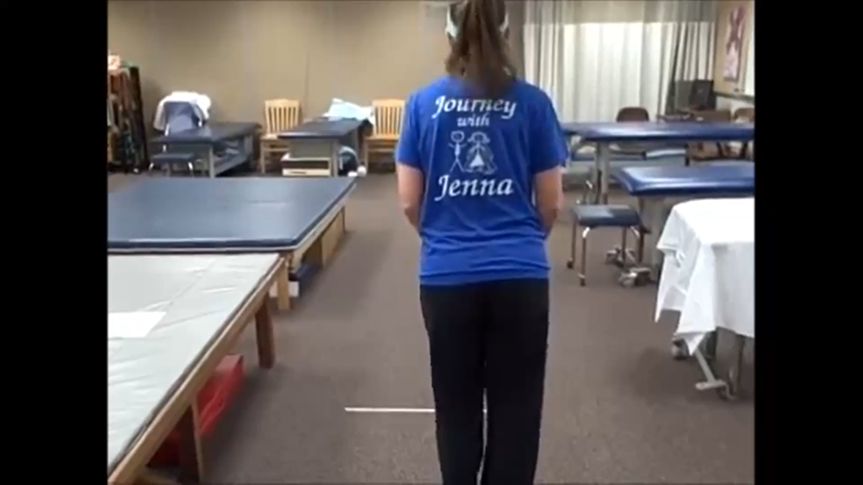
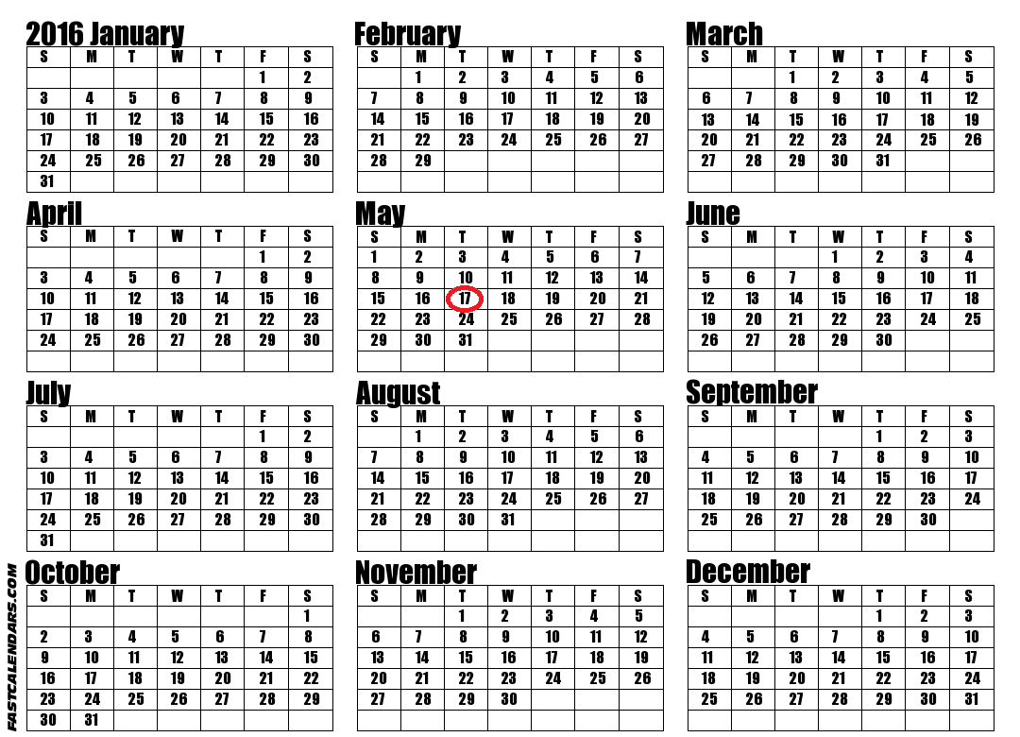
Problem Statement - Current Methods
Current problems
Less doctor visits => less data
Less data => increased chance to miss significant changes in patient
Only shows small snapshot
  Not very accurate
  Gait can fluctuate a lot
Very little data to make decisions from
Medication type or dosage may not be the best fit
Notes:
Left side: Add video for PD assessment (directly add it)
Right side: One year calendar (circle days the patient visits the doctor for data collection), medication guidelines (doseages, show how these can drastically vary in levels for even one medication)

Slide 7
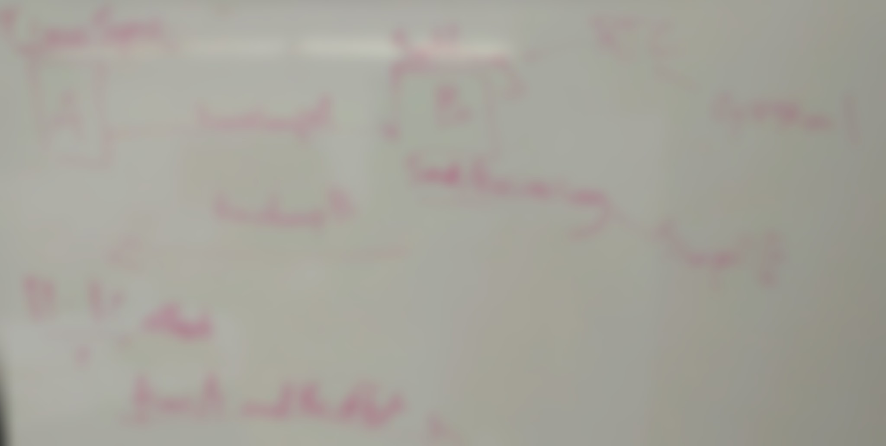
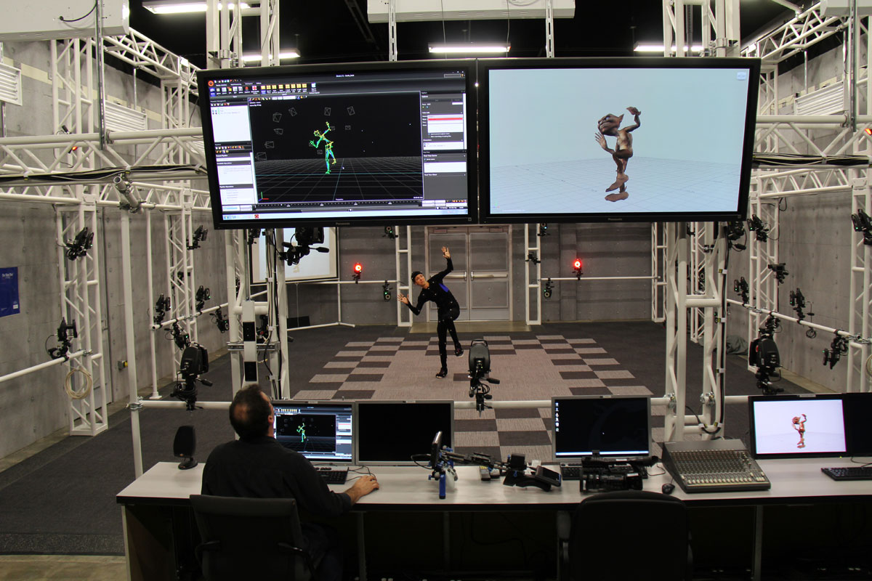
Current Method - Motion Capturing Technologies (i.e Vicon)

Slide 8
Notes:
Show current hardware and how they tend to only be worn on one area of the body
We get data from current wearables, but it’s not good enough (we need better frequency, more points)
Established data rates to get data for 3D motion (high framerate, data synchronization)

Slide 9
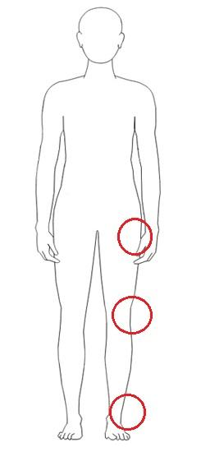
Solution
A wearable device (e.g KineTrax) that can record a variety of USEABLE sensor data over an extended period of time.
Can analyze day to day data for a month before offloading.
Notes:
Less texts, more figures/data (i.e. 32GB, Month, points worn on the body, 6-axis IMU, point to radio antenna, I2C supports 125 more sensors)
What are other kinds of I2C devices? (GPS)
More applications than just person wearable (i.e. cattle)

Slide 10
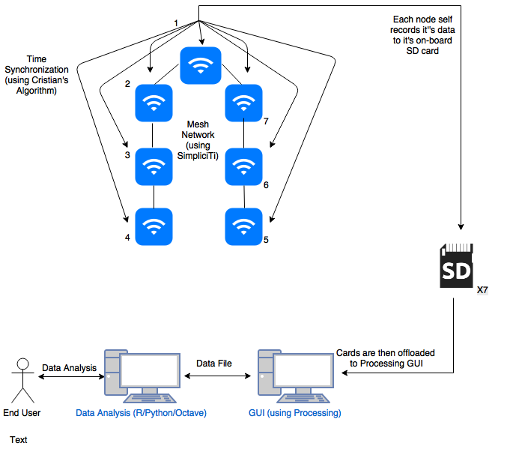
Solution - System Diagram
Notes:
Less texts, more figures/data (i.e. 32GB, Month, points worn on the body, 6-axis IMU, point to radio antenna, I2C supports 125 more sensors)
What are other kinds of I2C devices? (GPS)
More applications than just person wearable (i.e. cattle)
Why 7?
Chest- center mass
Ankle, knee, hip - measure gait

Slide 11
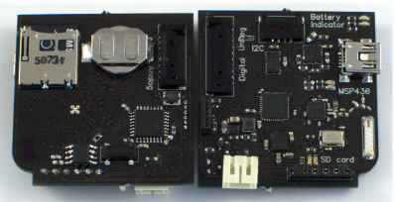
Solution - Key Chip Parts
Tracks time
Records data (accelerometer) daily into 32GB (per month storage)
I2C(RTC protocol)
SD CARD
Radio antenna(communication to other KineTrax devices)
Gets data from different parts of body
MSP430 CHIP
Notes:
Less texts, more figures/data (i.e. 32GB, Month, points worn on the body, 6-axis IMU, point to radio antenna, I2C supports 125 more sensors)
What are other kinds of I2C devices? (GPS)
More applications than just person wearable (i.e. cattle)

Slide 12
Functional Requirements
Self-assembling network between devices
Automatic synchronization of clock time between devices
Adjustable sampling rate
Assessment of distance and signal strength between devices
User GUI to interact with the device
Offload records to a standard format (i.e csv, etc.)
Notes:
Talk about drift in millisecond precision (needs to be stable, like drift of 1 millisecond over a day instead of drifting every second)

Slide 13
Performance Requirements
Time is synchronized between devices down to millisecond precision
Sample rate must be at least 100 Hz
Drift needs to be stable, ideally no more than 1 millisecond every day.

Slide 14
Environmental Requirements
Embedded software must be coded in C
Software must run on MSP430 equipment
Data offloading must be done with Processing
Networking must be done with the SimpliciTi protocol
Notes:
Ada vs C vs C++ for embedded options (we DO have other options, but they’re not GOOD options -> environmental “guideline”
Networking Protocol, how we’re extending stack

Slide 15
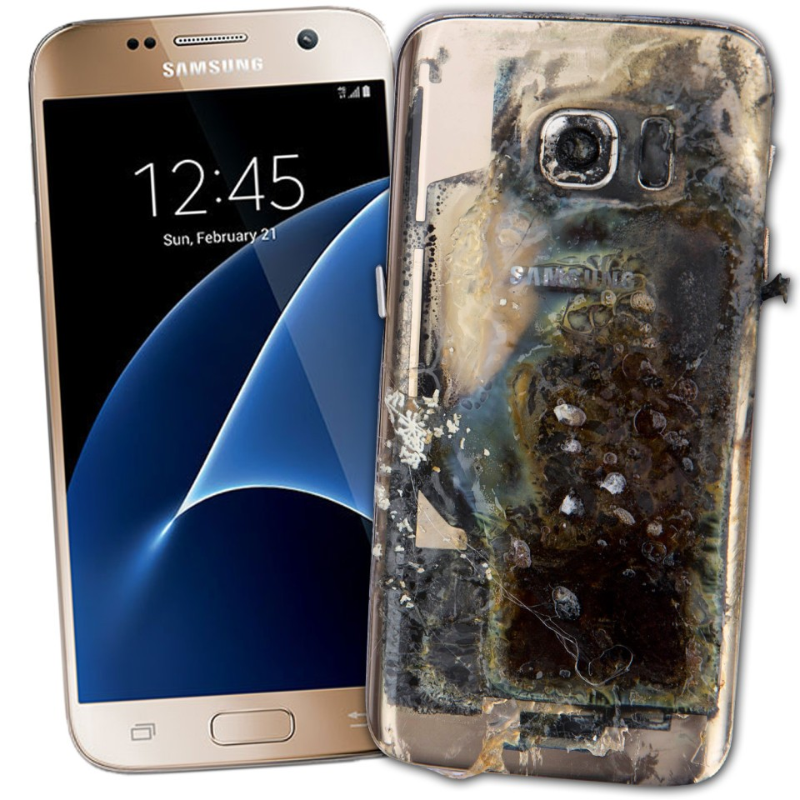
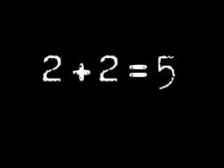
Potential Risks
Private personal data could be maliciously used against the user
  Insurance companies up cost of coverage
  Job security
Gathered inaccurate and/or unusable data
Improperly written/designed software could cause overheating on the device

Slide 16
Schedule
 | January | February | March | April | May
Wireless communication dev.
Time sync dev.
Distance calculation dev.
GUI dev.
Offloading data dev.
Data acquisition dev.
Testing
Notes:
Distance esitmate (0-30ft)
If we’re clever, we could determine device position by the type of motion it’s recording
Rotional accelerometer for arduino is a good example
Zero-update protocol
Grab distance points (between devices) from radio signal strength
Arrow from Yellow Jan -> Blue February
A paper about the design of the KineTrax (optional, external)
FIX MEEEEE

Slide 17
Conclusion
Current method of gait analysis are limited
KineTrax seeks to overcome these limitations
  Adaptable hardware
Impacts a large population
Will change the way neurological impairments are analysed
Notes:
PICTURES
Backup slides for potential questions/explanations

Slide 18
References
[1] Google glass image. http://www.shinyshiny.tv/2014/07/google-offers-free-demos-glass.html
[2] Fitbit image. http://descriptionebooks.com/fitbit/fitbit-flex.html
[3] http://www.cgadvertising.com/pages/posts/vicon-technologies-give-usc-students-hands-on-motion-capture-experience-128.php Vicon Image
[4] https://images.duckduckgo.com/iu/?u=https%3A%2F%2Fghr.nlm.nih.gov%2Fart%2Flarge%2Fmotor-neuron.jpeg&f=1 Motior Neuron Picture
[5] http://www.damarque.com/nl/blog/gianluigi-cuccureddu/three-ways-bad-data-affects-your-customer-experiences-infographic
[6] http://news.softpedia.com/news/samsung-galaxy-s7-edge-allegedly-catches-fire-in-canada-509573.shtml

